Slide 1
Density Profiles of Dynamical Dark Matter Halos
Tristen Shields
Dr. Eduardo Rozo, Aakanksha Adya, Edgar Salazar
University of Arizona
Arizona Space Grant Statewide Student Research Symposium

Slide 2
The Cosmic Web
The large scale structure of the universe forms a "web" of matter
Each bright knot in the web has a galaxy
We know visible matter can't form galaxies by itself
Each galaxy is formed with the help of a dark matter halo
Image Credit: Springel et al. (2005)
Notes:
NOT galaxies-density distribution

Slide 3
The Cosmic Web
The large scale structure of the universe forms a "web" of matter
Each bright knot in the web has a galaxy
We know visible matter can't form galaxies by itself
Each galaxy is formed with the help of a dark matter halo
Image Credit: Springel et al. (2005)
Notes:
NOT galaxies-density distribution

Slide 4
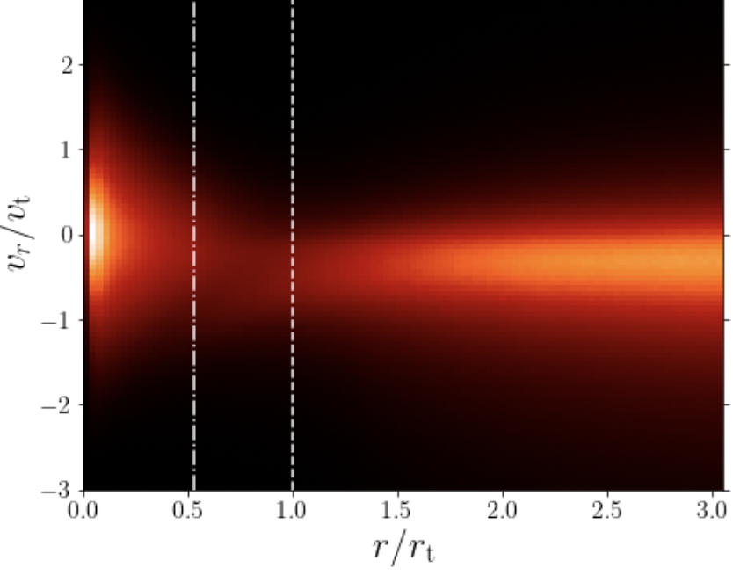
What is a Halo?
Traditionally, halos have been defined using a radial cut
This definition is not physical
It is better to define a halo using how each particle moves
We split each particle for each halo as "orbiting" or "infalling"
A halo is then the collection of its orbiting particles
Image Credit: García et al. 2022
Notes:
Draw line between orbiting and infalling, keep no more than 2 lines of text per bullet
"spherical overdensities" ==> "radial cut"
"Recent work has shown that" ==> "it is better to"

Slide 5
What is a Halo?
Traditionally, halos have been defined using a radial cut
This definition is not physical
It is better to define a halo using how each particle moves
We split each particle for each halo as "orbiting" or "infalling"
A halo is then the collection of its orbiting particles
Image Credit: García et al. 2022
Notes:
Draw line between orbiting and infalling, keep no more than 2 lines of text per bullet
"spherical overdensities" ==> "radial cut"
"Recent work has shown that" ==> "it is better to"

Slide 6
What is a Halo?
Traditionally, halos have been defined using a radial cut
This definition is not physical
It is better to define a halo using how each particle moves
We split each particle for each halo as "orbiting" or "infalling"
A halo is then the collection of its orbiting particles
Image Credit: García et al. 2022
Notes:
Draw line between orbiting and infalling, keep no more than 2 lines of text per bullet
"spherical overdensities" ==> "radial cut"
"Recent work has shown that" ==> "it is better to"

Slide 7
What is a Halo?
Traditionally, halos have been defined using a radial cut
This definition is not physical
It is better to define a halo using how each particle moves
We split each particle for each halo as "orbiting" or "infalling"
A halo is then the collection of its orbiting particles
Orbiting
Infalling
Image Credit: García et al. 2022
Notes:
Draw line between orbiting and infalling, keep no more than 2 lines of text per bullet
"spherical overdensities" ==> "radial cut"
"Recent work has shown that" ==> "it is better to"

Slide 8
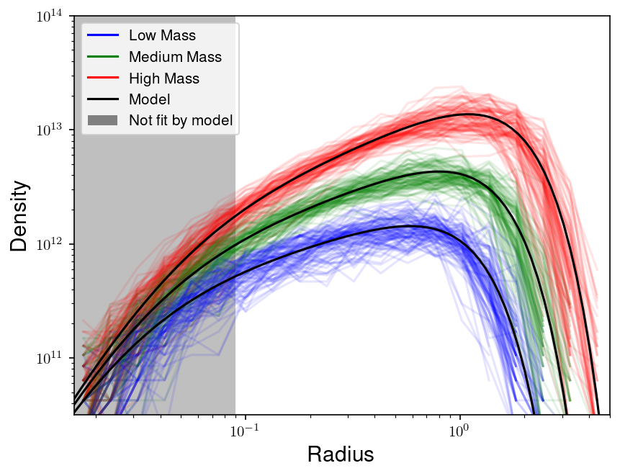
The Orbiting Density Model
We have a model for halo density with radius
It depends on two parameters:
The halo radius (rh)
The profile slope (alpha)
This works for the average density profile

Slide 9
The Orbiting Density Model
We have a model for halo density with radius
It depends on two parameters:
The halo radius (rh)
The profile slope (alpha)
This works for the average density profile
rh
alpha

Slide 10
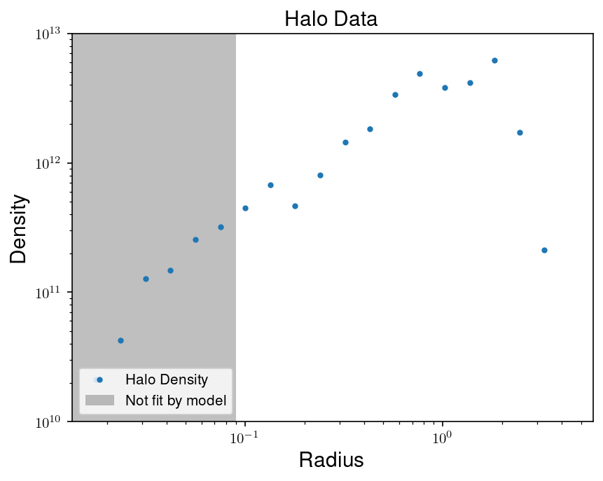
Fitting Individual Halos
The model works well on average halo densities
For individual halos, it's better to fit for rh and alpha
Problem: How can we describe the range of halo profiles?

Slide 11
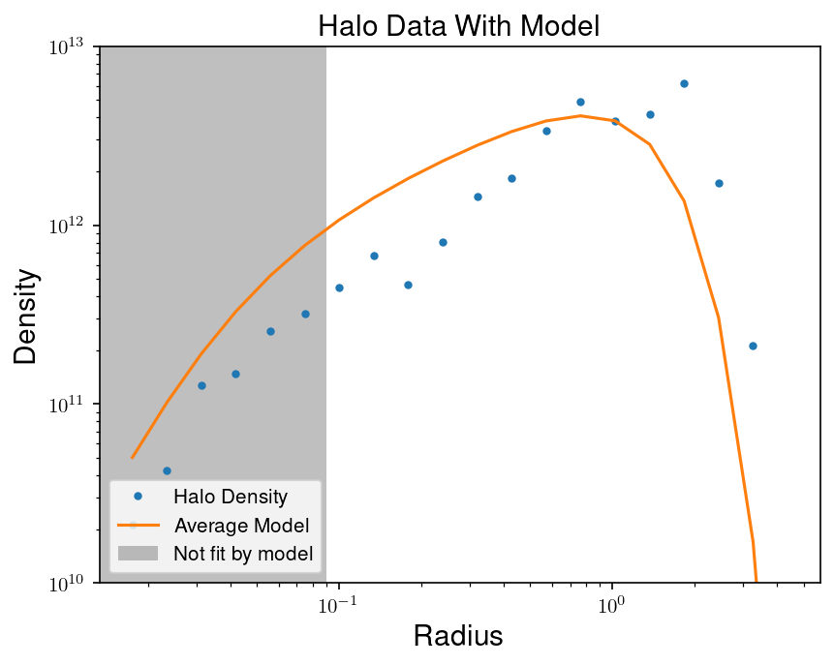
Fitting Individual Halos
The model works well on average
For individual halos, it's better to fit for rh and alpha
Problem: How can we describe the range of halo profiles?

Slide 12
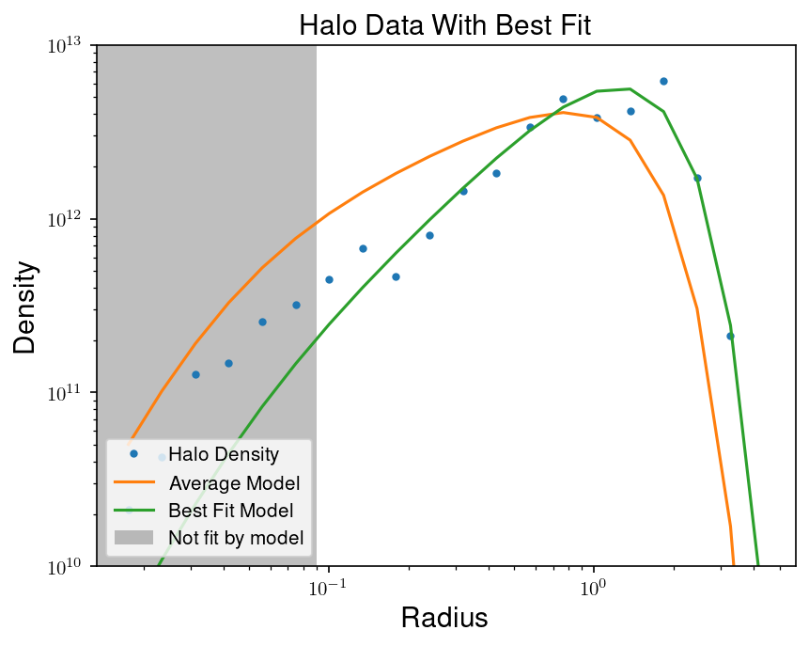
Fitting Individual Halos
The model works well on average
For individual halos, it's better to fit for rh and alpha
Problem: How can we describe the range of halo profiles?

Slide 13
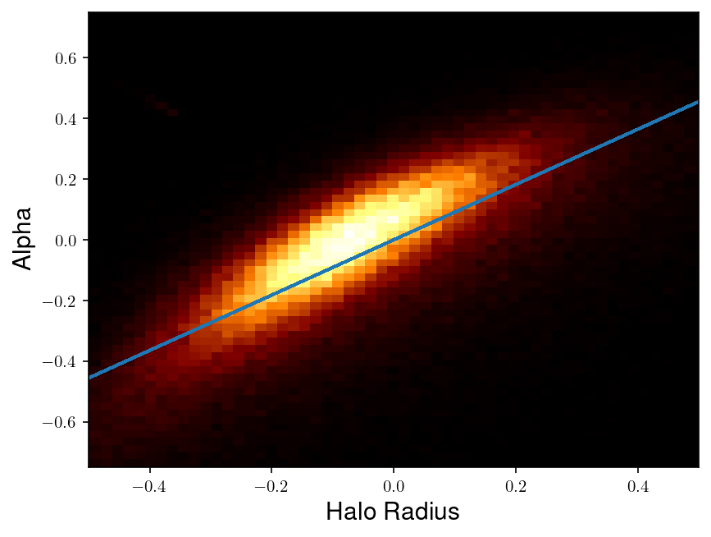
We Only Need One Parameter
We fit the two parameters for every halo
Plotting them against each other shows a correlation
We can write alpha in terms of rh in the model
If we know rh for a halo, then we know its alpha

Slide 14
Summary
Dynamical dark matter halos are described by a model that can work for the average profile
The model has two parameters, the halo radius and the profile slope
There is a sharp correlation between the halo radius and the profile slope
For individual halos, we can describe its profile by just fitting for its halo radius

Slide 15
Thank you!
Acknowledgements:
Dr. Eduardo Rozo
Aakanksha Adya
Edgar Salazar
Arizona Space Grant Consortium
University of Arizona Department of Physics
For questions:
tdshield@arizona.edu

